Slide 1
Understanding and Managing Extreme Event Risk: The Insurance Industry

Slide 2
Product Risk
The uncertainty of the insurance business lies in the fact that the costs of goods sold is not known at the time of production/contract (Deutsche Bank, 2010)
Modelling must be an intrinsic part of the product

Slide 3
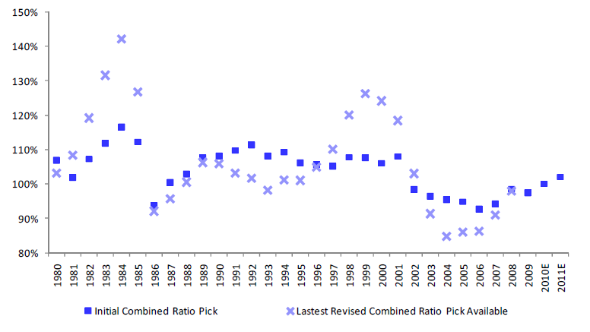
Combined Ratio P&C Market
Combined ratio =
Incurred Loss + Expenses
Earned Premium
Relying on Investment Returns
Underwriting Returns
Source: A.M. Best’s Aggregates and Deutsche Bank
Notes:
3

Slide 4
Stock Multiple: “No Bubble…”
“No Bubble, smile…”! Anticipating Subpar Returns for P&C Insurers

Slide 5
Insurance Principles
Large number of similar exposure units: Pooling Resources
Definite loss: Space/time
Accidental loss: Outside the control of beneficiary
Large loss: Meaningful from perspective of insured
Affordable premium: Premium/limit reasonable
Calculable loss: Likelihood and cost
Limited risk of catastrophically large losses: “finite loss”
Mitigation, make expected higher future loss costs affordable and help increase Resilience

Slide 6
Insurance Promise
Deliver on promises:
Cash for Individual/high frequency losses,
Capital for catastrophes,
Assets/Investment Book, (moderate risk)
To meet post-catastrophe needs, insurers draw on multiple resources
Liquidity–meet customers immediate needs for payment
Income statement vs. balance sheet events
Capital resources
  Surplus/equity –must make profit in non-cat years
  Line of credit
  Reinsurance (R/I)
Large R/I programs may have 90+ reinsurers
Billions in limits placed

Slide 7
All About Capital Cost
“Rating” for banking business vs. probabilistically modeled losses for Insurance, (VAR, TVAR)
Capital is required for Tail Risk
Capital Cost: 7-17%
Reinsured for 2-4% of limit insured,
An “Earnings Call” is a loss that can be paid using the Premium
diversification
Loss
Capital
ROC!
Earnings
1/200
RP

Slide 8
Risk/Capital Sharing
Governments
Required Return on Capital (ROC):
Insurance (tail): 7-17%
Collateral Insurance: >5% (small)
Reinsurance: 2-4% (other than tail)
Capital Market: 1-5% (high fees!)
Governments: small (tax), endangered!
50 to>90%
Fire/WS Ins
Penetration
Capital
Market
1/200
Reinsurance
Insurance
Collat.
Market
FL/EQ Ins
Owner
5 to <1%
Developed Countries
Developing Countries

Slide 9
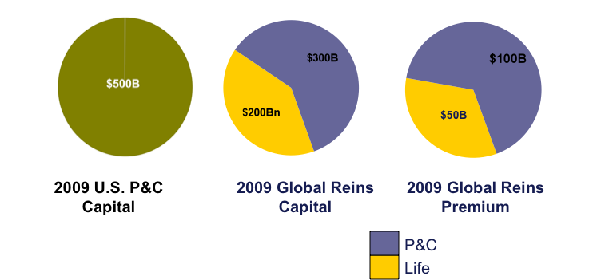
Global P&C Capital &
RI Capital & Premium

Slide 10
Largest Losses Since 1990 as of 2011
Event YR Ins USD Econ USD
HU Katrina 2005 70bn(120bn) 130bn
HU Andrew 1992 40bn 80bn
Tohoku EQ 2011 30bn(>80bn) 300-500bn
Northr. EQ 1994 30bn 100bn
HU Ike 2008 19bn 38bn
Thailand FL 2011 10+(?)bn ?
...
Lothar WS 1999 14bn 27bn
Daria WS 1990 14bn 30bn
...
NZ EQ 2011 13bn 17bn
Chile EQ 2010 8bn 14bn
NZ EQ 2010 5bn 8bn
Queens. FL 2011 3bn 5bn
Insured Tohoku losses (alone) were subject to “an earnings call” for most (income statement not balance sheet)

Slide 11
Bearish and Bullish, the Market Cycle
Markets harden after large property event losses and/or in case of casualty losses (longer term)
If significant Capital is lost
And influx of capital is restricted!
Market hardened 1992/3, 2001/2 in 2005/6 (short-term)
2011 sees (so far) risk adjusted flat to minor price increase
Distribution of losses (LOBs, Countries) play a role
Hazards follow regimes/cycles as well…

Slide 12
Insurance Regulation (Example Solvency II)
EU-wide Principles (2013)
Risk-based capital requirements are based on principles not rules
The firm’s governance and risk management must match its risk profile, ERM strategy
The Solvency Capital Requirement (SCR) covers all risks (convoluted) faced by the firm for a 1-in-200 year confidence level
The SCR can be calculated using either the standard (risk intensive) formula or an internal model
In cutting the tail (1/200) insurance premium stays affordable

Slide 13
Calculable Loss: Platforms for Trading
Risk Models: Vendor and in-house tools
50% of WW property exposure and >75% GDP related risk represented in models (EQ, WS, Terror, FL, Fire, Surge, Tsunami and more)
Thesis: The primary purpose of vendor catastrophe models is to provide a “currency” to trade with

Slide 14
Risk Management: Informed by Models
Deterministic:
Maximum Downside, Loss Limits, Aggregates, Maximum Foreseeable Loss (MFL), Realistic Disaster Scenarios,
Probabilistic:
Pricing and Probable Maximum and Return Period Losses,
ERM, Capital Requirements
Hybrid:
Portfolio Management, Pricing for Perils such as Terror, or Tornado (US), Cyber Risk, War, Asset Management, and more

Slide 15










































WRN Partner Institutions
15
Notes:
15

Slide 16
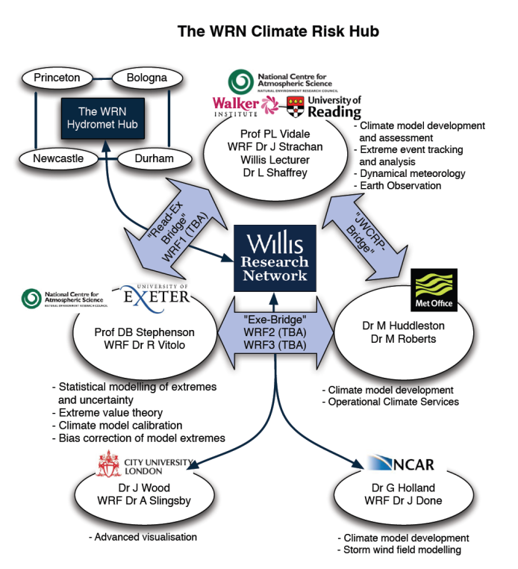
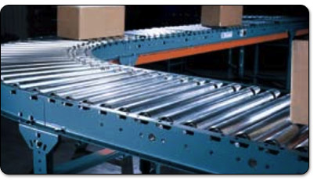

Hubs: Products and Services
WRN Hubs:
  Climate Risk Hub (CRH),
  Earthquake Risk Hub (ERH),
  Hydro Risk Hub (HRH),
  Impact Risk Hub (IRH),
  Financial Risk Hub (FRH),
  Geospatial, Platforms & Service Hub,
  PD: Internal Translation!
CRH
5
4
3
T1
2
1

Slide 17
WRN Purpose
Largest Risk Network in Finance/Science Market (Private Public Academic Partnership, PPA)
Increase resilience by Increasing Insurance Penetration
Increase Capital Influx
Increase Insurance penetration by making risk further calculable
Increase Reputation of Market
Decrease Systemic Risk by Increasing variety of risk results
Inform Market, Educate Regulators and Rating Agencies

Slide 18
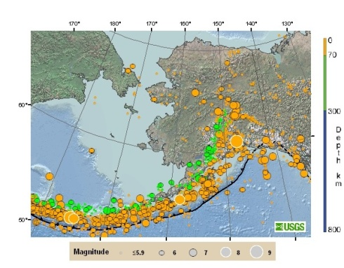
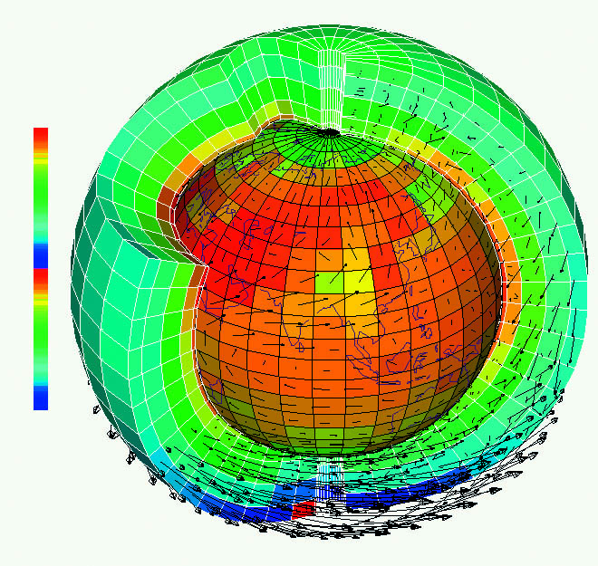
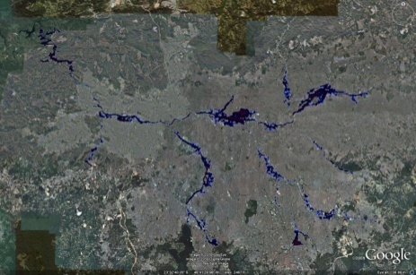
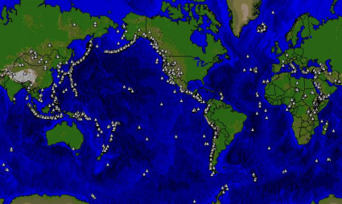
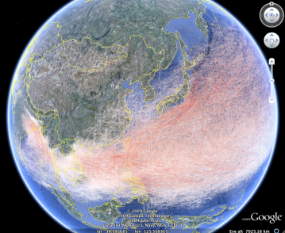
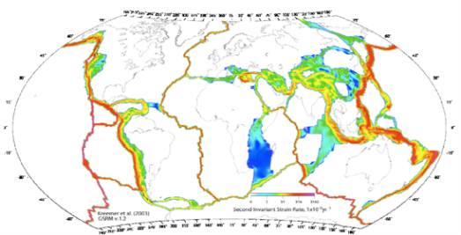
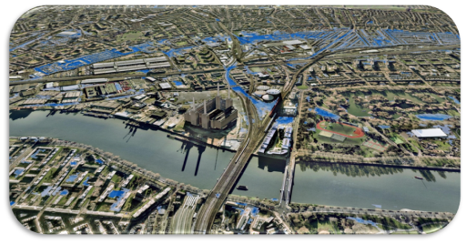
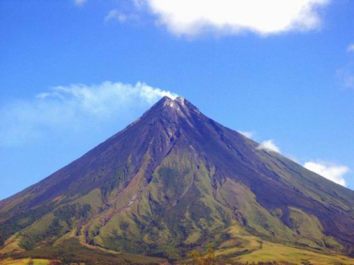

Willis Group, WRN “Gs”
GWM
Global WS, Correlation, variability, & trends
GEM
Global EQ, Global and regional risk, Exposure, portfolio management
GFM
Global FL, Regional and global rainfall, indices, rating & portfolio mgt.
GVM
Global Volc.
Global Eruption risk plus consequences
GRM
Global Risk Maps
Global Hazard and Risk Lookup
Rating
PMLs
Multi-hazard
Impact, Finance. Model, Expos.
IBM, Met Office, Willis, others
Bristol, Smiths., USGS, Willis…
Willis, Met Office, CEDIM
GCM, ACRE, etc.
Tbd.
WRN
July 2011
WRN
Partially
Open Source
Open Source
Open Source
18
Notes:
18

Slide 19
Risk Formula
Change,
Consensus,
Self-organized Similarity
Risk = Hazard x Consequences x Perception
Vulnerability,
Exposure,
Claims Management etc.

Slide 20
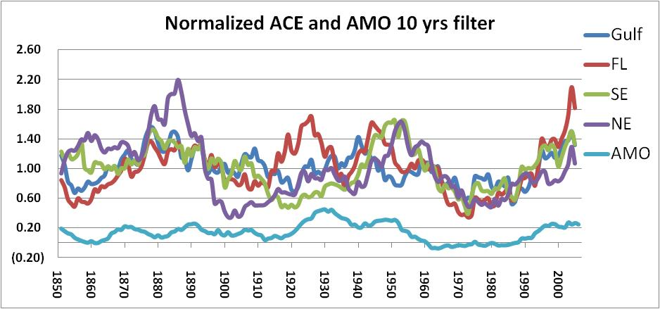
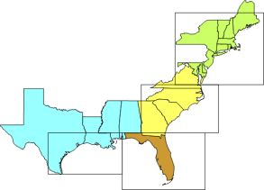
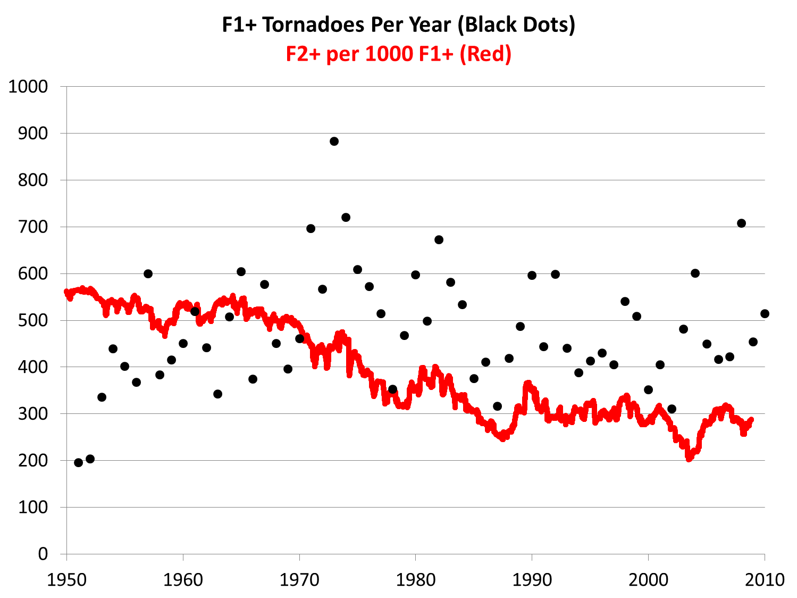
Trends
NOAA Hurdat reanalysis: Storms in a box since 1851
F-scale adopted
1950
Harold Brooks, 2011
2010

Slide 21
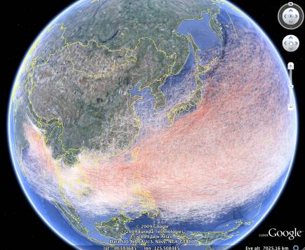
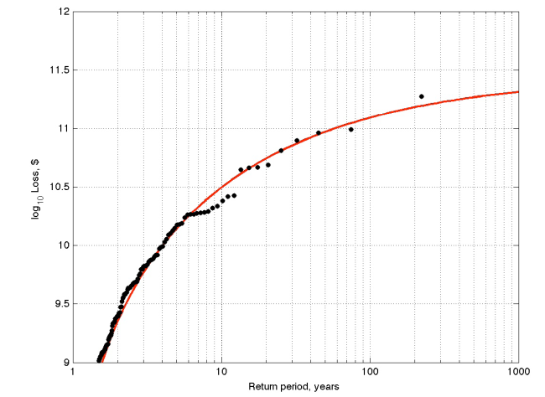
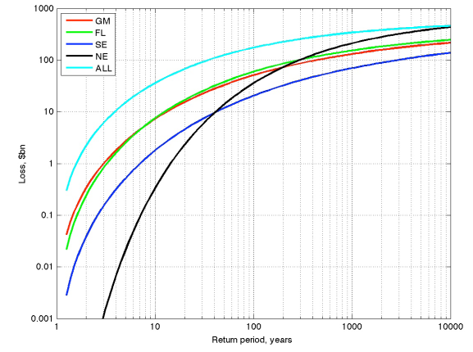
Global Models
Global interaction, Clustering, teleconnections
Dynamical downscaling
Inform Regional Models
Global and regional Indices
GEM, GFM, GVM, GWM..
21
21
Notes:
21
21
Governing differential equations
State of the art modeling
What is possible using GCMs
Derive tracks globally
Understand teleconnections, correlation between basins
Understand short term regimes and inertia in these regimes
Understand extremes and related changes in likelihood
Understand climate change (IPCC)

Slide 22
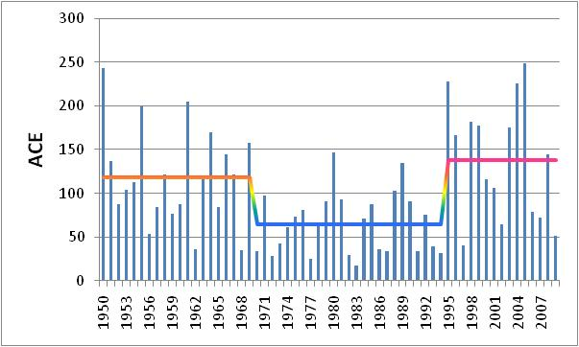
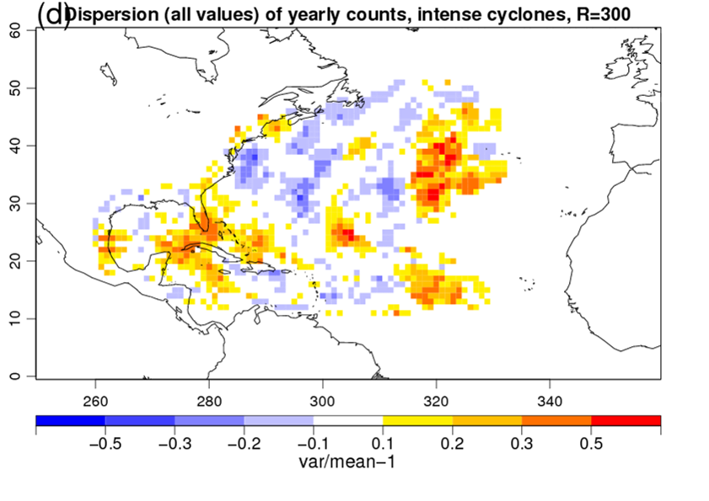
Multi-year Clustering is Real!
NOAA Hurdat reanalysis: Storms in a box since 1851
Accumulated Cyclone Energy,
High regime years: Katrina: 1/11
Low regime years: Katrina: 1/250
2005: Katrina: 1/5
Dispersion Statistic: φ=var/mean (of the counts).
φ>0 indicates clustering
22
Notes:
22
Katrina a 1/11 in largest 30% a 1/250 smallest 30%, at average 1/25 or 1 in 5 in Katrina year

Slide 23
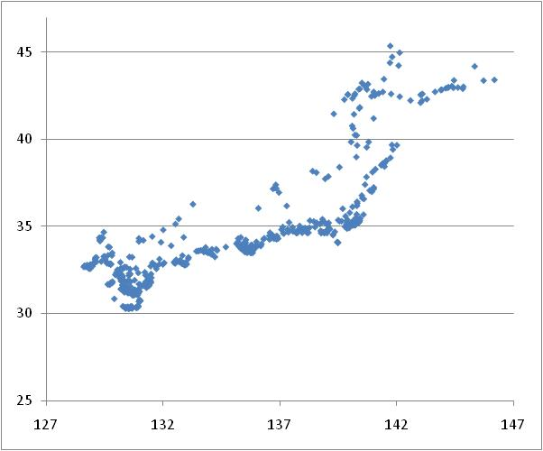
Global Allocation of Capital
Large Regional Differences!
JPWS, GCM landfall, only, ACE(proxy): random in time
Various tests suggest that storm occurrence follows Poissonian distribution
No evidence for multi-year clustering/regimes for Japanese Windstorm!

Slide 24
Extreme Event Risk Towards a More Resilient Future
Make natural and other perils insurance affordable by increasing penetration
Allow further Competition in Risk Taking/Results and wider ranges of solutions
Bring New Insurance Schemes into areas/LOBs that currently can be approached only marginally without a risk model
Foster influx of New Capital, allow trading
Increase Reputation of our Market, educate Rating and Regulation
Allow and Share Risk: We cannot afford being conservative and cannot do it alone!

